Slide 1
Rhetoric and Rhetorical Devices

Slide 2
What is Rhetoric?
The skill of choosing words that are most effective for persuading or for creating visual images in the listener’s or reader’s mind.

Slide 3
3 Categories
Pathos (Emotional)
Ethos (Ethical)
Logos (Logical)

Slide 4
Pathos
This type of appeal attempts to persuade the reader or listener by appealing to the senses and emotions.
Usually include statements with vivid sensory details, which are used to awaken the senses and perhaps manipulate the emotions of the audience.
Political ads that show politicians kissing babies or shaking hands with the elderly often appeal to the emotions.

Slide 5
Ethos
This type of appeal attempts to persuade the reader or listener by focusing on the qualifications of the speaker.
The speaker’s credibility is paramount in an ethical appeal.
Ethical appeals focus more on the speaker even more than the situation.

Slide 6
Examples of ethical appeals
Celebrity endorsements
A teen’s argument that he or she should be allowed to do something because he or she has never been in trouble, or because his or her friend is a perfect citizen and so on.

Slide 7
Logos
This type of appeal attempts to persuade the reader or listener by leading him down the road of logic and causing him to come to his own conclusion.
Logical appeals state the facts and show how facts are interrelated.
If/then statements are examples of logical appeals.
Logical appeals are often used in courtroom situations.

Slide 8
RHETORICAL
DEVICES

Slide 9
ANAPHORA
Repetition at the beginning of two or more successive verses, clauses, lines, or sentences.
I have a dream that one day this nation will rise up and live out the true meaning of its creed: "We hold these truths to be self-evident, that all men are created equal."
I have a dream that one day on the red hills of Georgia, the sons of former slaves and the sons of former slave owners will be able to sit down together at the table of brotherhood.
I have a dream that one day even the state of Mississippi, a state sweltering with the heat of injustice, sweltering with the heat of oppression, will be transformed into an oasis of freedom and justice.
I have a dream that my four little children will one day live in a nation where they will not be judged by the color of their skin but by the content of their character.

Slide 10
Aphorism
A concise statement of truth (principle).
If you always do what you always did, you will always get what you always got." (Jackie "Moms" Mabley)
Your children need your presence more than your presents." (Jesse Jackson)
"I disapprove of what you say, but I will defend to the death your right to say it." (often attributed to Voltaire, the words are in fact Tallentyre's summary of Voltaire's attitude toward Helvetius after the burning of the latter's writings)

Slide 11
Parallelism
The use of repeated grammatical structures.
a noun is listed with other nouns, an -ing form with other -ing forms, and so on.
Immature poets imitate; mature poets steal." (T.S. Eliot, "Philip Massinger," 1920) "O well for the fisherman's boy, That he shouts with his sister at play! O well for the sailor lad, That he sings in his boat on the bay!" (Alfred Lord Tennyson, "Break, Break, Break," 1842) "Today's students can put dope in their veins or hope in their brains. If they can conceive it and believe it, they can achieve it. They must know it is not their aptitude but their attitude that will determine their altitude." (Jesse Jackson)

Slide 12
Allusion
A direct or indirect reference to something from history, the Bible, etc.
Allusions engage the reader and will often help the reader remember the message or theme of the passage.
Allusions allow the writer to give an example or get a point across without going into a lengthy discourse.

Slide 13
Examples of Allusions
“I was surprised his nose was not growing like Pinocchio’s.” This refers to the story of Pinocchio, where his nose grew whenever he told a lie. It is from The Adventures of Pinocchio, written by Carlo Collodi.
“When she lost her job, she acted like a Scrooge, and refused to buy anything that wasn’t necessary.” Scrooge was an extremely stingy character from Charles Dickens’, A Christmas Carol.

Slide 14
Rhetorical Questions
A question for which the answer is obvious.
A response is not necessary.
“Why are you so stupid?”
“Why me?”

Slide 15
Argument by Analogy
A comparison of two similar situations, implying that the outcome of one will resemble the outcome of the other.
There might be life on Europa because it has an atmosphere that contains oxygen just like the Earth.
This novel is supposed to have a similar plot like the other one we have read, so probably it is also very boring.
The universe is a complex system like a watch. We wouldn't think that a watch can come about by accident. Something so complicated must have been created by someone. The universe is a lot more complicated, so it must have been created by a being who is a lot more intelligent.

Slide 16
Others
Similes and Metaphors
Irony
Imagery
Syntax
Quotes

Slide 17
What is Irony?
Irony is about expectations.
Irony: the opposite of what is expected.
3 kinds of irony
Verbal
Dramatic
Situational

Slide 18
Verbal Irony
A character says one thing but means the opposite
Also called sarcasm or being sarcastic.
Examples
The locker room smells really good.
Awesome! Another homework packet!

Slide 19
Dramatic Irony
When the reader understands more about the events of a story than a character.
You know something that a character doesn’t.
Example
Tim’s parents are proud of the “A” he got on the test, but we know he cheated.
Alex writes a love poem to Judy but we know that Judy loves Devin.

Slide 20
Situational Irony
When what actually happens is the opposite of what is expected.
Something about the situation is completely unexpected.
Example
General Sedgwick’s last words were, “They couldn’t hit an elephant at this distance.”
Bill Gates uses an Apple computer.

Slide 21
Review
Something that is ironic is unexpected.
If unexpected by a character, it’s dramatic.
If unexpected by everyone, it’s situational.
If it’s sarcasm, it’s verbal.

Slide 22
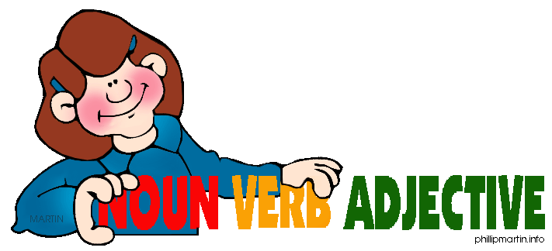
Syntax

Slide 23
Sentence Purpose
Declarative- makes a statement
Interrogative- asks a question
Exclamatory- provides emphasis or strong emotion
Imperative- gives a command

Slide 24
Sentence Length
Telegraphic- sentences shorter than 5 words in length
Short- sentences approximately 5 words in length
Medium- sentences approximately 18 words in length
Long- sentences 30 words or more in length

Slide 25
Sentence Structure
Simple- one independent clause
Compound- two independent clauses joined by a coordinating conjunction or semicolon
Complex- an independent clause and one or more subordinate clause
Compound-complex- contains two or more independent clauses and one or more subordinate clauses

Slide 26
Cumulative (or loose)
Makes complete sense if brought to a close before the actual ending
We reached New York that morning after a turbulent flight and some exciting experiences, tired but exhilarated, full of stories to tell our friends and neighbors.

Slide 27
Periodic
Makes sense fully only when the end of the sentenced is reached
That morning, after a turbulent flight and some exciting experiences, we reached New York.

Slide 28
Balanced
The phrase or clauses balance each other by virtue of their likeness of structure, meaning or length
He maketh me to lie down in green pastures; he leadeth me beside the still waters.

Slide 29
Sentence Order
Natural- involves constructing a sentence so the subject comes before the predicate
The group sat beside the swimming pool.

Slide 30
Inverted
Involves constructing a sentence so the predicate comes before the subject. This can create an emphatic or rhythmic effect
Beside the swimming pool sat the group.

